Slide 1
Course Name : Data Structures & Algorithms
Dr. S. Nandagopalan
Computer Science & Information Systems

Slide 2
Session 9: Dijkstra’s, and Bellman-Ford

Slide 3
Contents
Dijkstra's Algorithm
Bellman-Ford Algorithm
Summary

Slide 4
Dijkstra's Algorithm
This algorithm finds the shortest path from a given vertex to all the remaining vertices in a graph (directed or undirected) called as single-source shortest path problem.
That is, how can we find the shortest path between two points on a map?
The Problem Statement
For a given weighted, graph G with n vertices we are supposed to find a shortest path from a given starting vertex, s to each vertex v ∈ V. The additional constraint is that the edge costs should be non-negative.

Slide 5
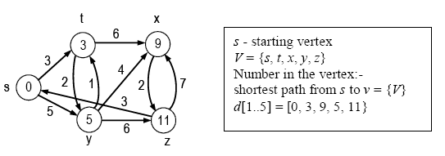
Example

Slide 6
Modular Solution
Every shortest path algorithm must have the following three modules:
Initialize_Single_Source(V, s)
This module will initialize the distance vector d, so that the Digikstras algorithm can update d in each iteration
Relax(u, v, w)
This second module is to update the distance vector d when a new shortest path is obtained as per the greedy strategy
Digikstras(G, s)
for each vertex v adjacent to u do
Relax(u, v, w)

Slide 7
Initialize_Single_Source(V, s)
■ Algorithm Initialize_Single_Source(V, s)
for each v ∈ V do
d[v] ← ∞
d[s] ← 0
end Initialize_Single_Source.

Slide 8
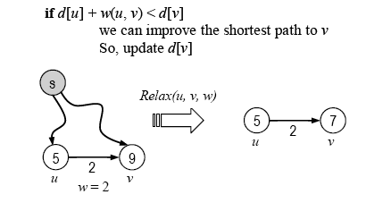
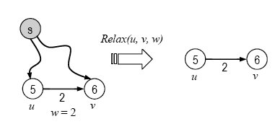
Relax(u, v, w)
Relaxing an edge (u, v) means testing whether we can improve the shortest path to v found so far by going through u.
■ Algorithm Relax(u, v, w)
if d[u] + w(u, v) < d[v]
d[v] ← d[u] + w(u, v)
end Relax.

Slide 9






Working
t
x
t
x
1
t
x
1
∞
∞
1
∞
8
14
10
10
9
10
10
9
0
2
3
4
6
9
0
2
3
4
6
s
s
0
2
3
4
6
s
7
7
5
7
5
∞
∞
5
5
∞
5
7
2
2
y
2
y
z
y
z
z
t
x
t
x
t
x
1
1
8
1
9
8
13
8
9
10
10
10
9
9
9
0
2
3
4
6
s
0
2
3
4
6
s
0
2
3
4
6
s
7
7
5
7
5
5
7
5
5
7
5
7
2
2
y
2
z
y
z
y
z

Slide 10
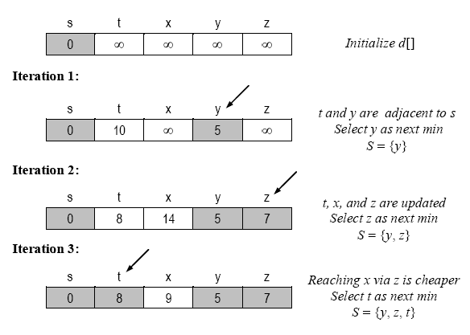
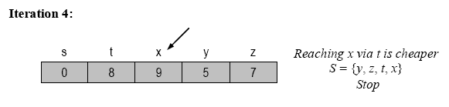
Distance vector
t
x
∞
1
∞
10
9
s
0
2
3
4
6
5
7
∞
∞
y
2
z

Slide 11
Algorithm
■ Algorithm Dijkstras(G, s)
// Input: Weighted Graph (directed/undirected) and a stating vertex s
// Output: Shortest path from s to all other vertices, i.e. d[1..n]
for each v ≠ s do // Initialize_Single_Source(V, s)
d[v] ← ∞
d[s] ← 0
S ← ø
Q ← V[G] // priority queue, Q contains all vertices of G
while Q ≠ ø do // using the d labels as keys
u ← getMin(Q)
S ← S ∪ {u} // vertices ‘seen’ already
for each vertex v adjacent to u and v ∉ S do
if d[u] + w(u, v) < d[v] // Relax(u, v, w)
d[v] ← d[u] + w(u, v)
return d.
end Digkstras.

Slide 12
Bellman-Ford Algorithm
Dijkstra’s doesn’t work when there are negative edges:
Intuition – we can not be greedy any more on the assumption that the lengths of paths will only increase in the future
Bellman-Ford algorithm detects negative cycles (returns false) or returns the shortest path-tree
Running time: Θ(VE)
Corollary. If a value d[v] fails to converge after |V| – 1 passes, there exists a negative-weight cycle in G reachable from s.

Slide 13
Algorithm
BELLMAN-FORD (G, w, s)
for each vertex v = V[G] do
d[v] ← 1
d[s] ← 0
for each vertex i = 1 to V[G] - 1 do
for each edge (u, v) in E[G] do
if d[u] + w(u, v) < d[v]
d[v] ← d[u] + w(u, v)
// look for negative cycle
for each edge (u, v) in E[G] do
if d[u] + w(u, v) < d[v]
return FALSE
return TRUE

Slide 14
Bellman-Ford Example-1
(u,v) (u,x)
(u,y)
(v,u)
(x,v)
(x,y)
(y,v)
(y,z)
(z,u)
(z,x)
u
5
v
5
-2
u
v
6
∞
∞
-2
6
6
∞
-3
8
-3
z
0
-4
7
8
2
z
0
-4
7
7
2
∞
∞
7
9
7
∞
x
y
9
x
y
u
v
u
5
v
u
5
v
-2
6
2
4
6
-2
4
2
-2
4
6
6
-3
-3
-3
z
0
8
8
8
-4
7
z
0
-4
7
z
0
-4
7
2
2
2
7
7
7
7
−2
7
2
7
2
9
9
9
x
y
x
y
x
y

Slide 15
Bellman-Ford Example-2
(a,b) (a,c)
(b,d)
(c,b)
(d,c)
a
b
a
b
0
5
∞
0
5
−2
4
-6
3
4
-6
3
∞
∞
4
8
2
2
c
d
c
d
a
b
a
b
0
5
−2
5
0
−3
// look for negative cycle
for each edge (u, v) in E[G] do
if d[u] + w(u, v) < d[v]
return FALSE
4
-6
3
4
-6
3
3
1
3
1
2
2
c
d
c
d

Slide 16
Bellman-Ford Example-3
a
b
a
b
0
1
∞
−2
1
1
(a,b) (b,d)
(d,c)
(c,a)
-1
-1
-1
-1
-1
-1
∞
∞
−1
0
c
d
c
d
a
b
a
b
−4
1
−1
−8
1
−5
// look for negative cycle
for each edge (u, v) in E[G] do
if d[u] + w(u, v) < d[v]
return FALSE
-1
-1
-1
-1
-1
-1
−3
−2
−7
−6
c
d
c
d

Slide 17
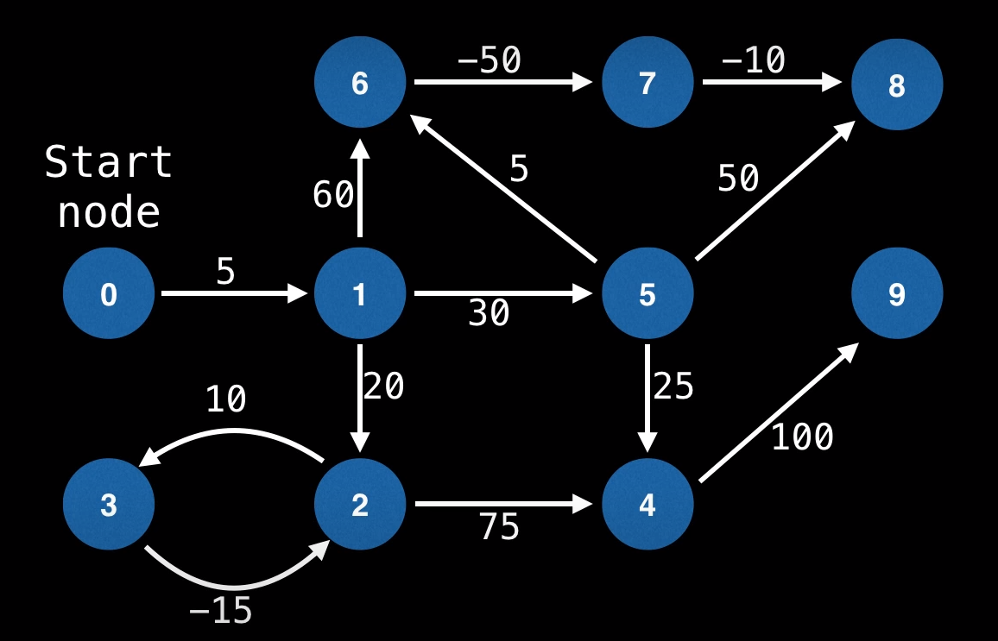
Exercise

Slide 18
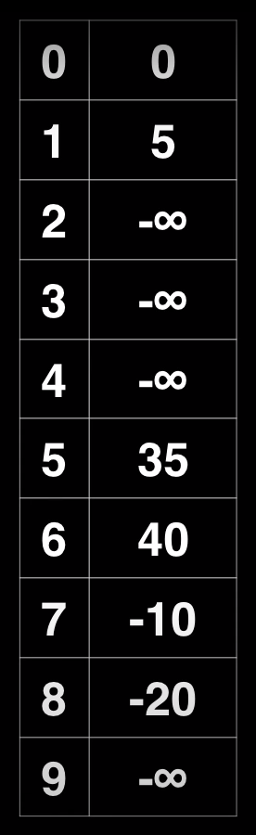
Output

Slide 19
Summary

